Slide 1
Strategic Capabilities for Megaproject Architects
Nuno Gil
Professor of New Infrastructure Development
Centre for Infrastructure Development, Manchester Business School
International Conference on Infrastructure Development and Investment
16-18 September, Livingstone, Zambia
© Nuno A. Gil. All Rights Reserved
Notes:
Like a kaleidoscope in which the view changes as it is rotated, any collaboration can be transformed as issues are addressed in this way

Slide 2
- What is a megaproject? - Who are the megaproject ‘architects’? - The issue of megaproject performance - Developing economies: What Changes? - Strategic capabilities for megaproject architects
Summary
© Nuno A. Gil. All Rights Reserved
Notes:
Like a kaleidoscope in which the view changes as it is rotated, any collaboration can be transformed as issues are addressed in this way

Slide 3
A ‘megaproject’ is a network of organizations formed to design and deliver a large infrastructure
© Nuno A. Gil. All Rights Reserved

Slide 4
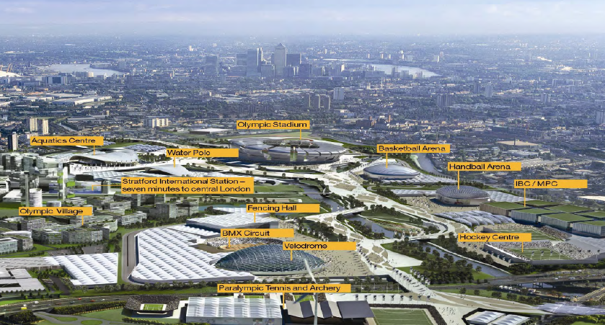
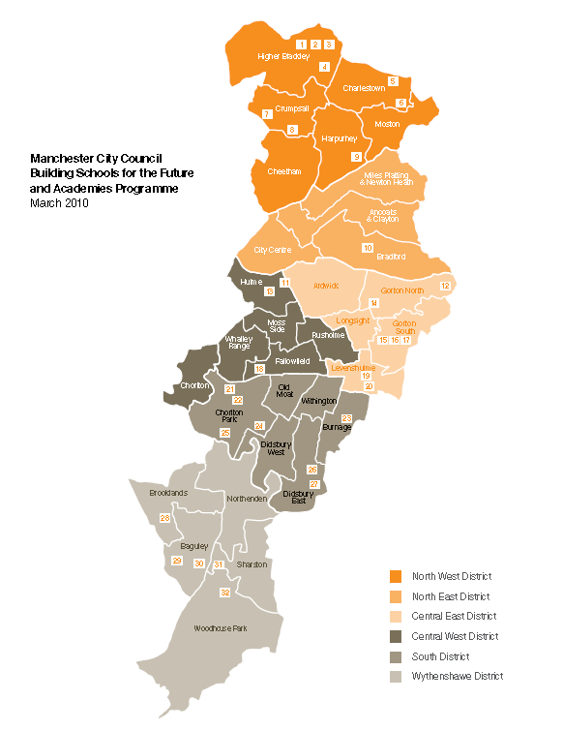
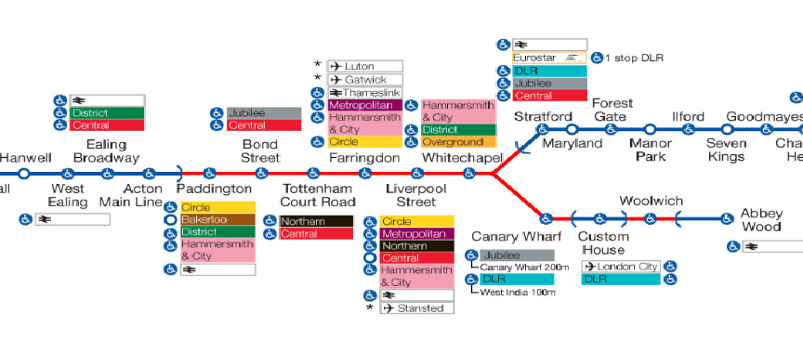
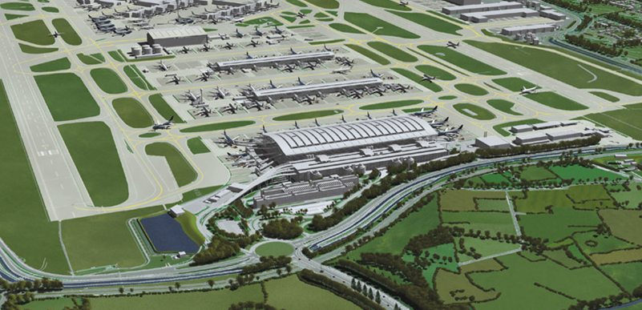
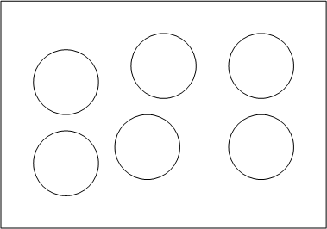
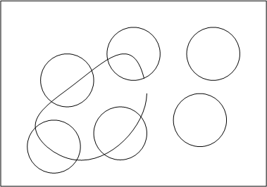
Infrastructure are systems of indivisible components
© Nuno A. Gil. All Rights Reserved

Slide 5
The Infrastructure Development Problem
TECHNOLOGICAL
FINANCIAL
POLITICAL
© Nuno A. Gil. All Rights Reserved

Slide 6
Infrastructure developments are led by coalitions of resource-rich actors
Land
Finance
Political Support
Knowledge of Needs (scope/design requirements)
Management and Technical Capabilities
© Nuno A. Gil. All Rights Reserved

Slide 7
In publicly-financed projects: i) elected officials (ministers, presidents, politicians) ii) top civil servants, local governors iii) financiers (multilateral agencies, donors, private partner) In industrial and PPP projects: i) top management teams (private firm) ii) elected officials iii) top civil servants, local governors
Megaproject architects
© Nuno A. Gil. All Rights Reserved

Slide 8
Megaproject networks are consensus-oriented at the core
Producers or megaproject
architects
High-level rules
A
E
B
C
D
User groups/
other stakeholders
Producers (high-level authorities, funders)
Local claimants (e.g., key user groups, other stakeholders)
© Nuno A. Gil. All Rights Reserved

Slide 9
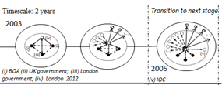
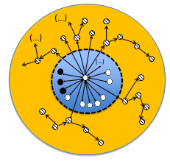
Megaproject networks are transactional at the periphery
© Nuno A. Gil. All Rights Reserved

Slide 10
Seeking consensus is hard work
Problem-solving oscillates between lower-level working groups (technocrats) and high-stakes group (political)
Parties use downstream suppliers to win the argument
© Nuno A. Gil. All Rights Reserved

Slide 11
Megaproject Performance
Ideation
Planning
Delivery
© Nuno A. Gil. All Rights Reserved

Slide 12
Megaproject Performance
Ideation
Planning
Delivery
© Nuno A. Gil. All Rights Reserved

Slide 13
What if it is the same project !?
Current prices @P50
Final prices @ P95
P50 Final Cost forecast
Ideation
Planning
Delivery
© Nuno A. Gil. All Rights Reserved

Slide 14
Stakeholder arrival and cost escalation are strongly correlated!
Ideation
Planning
Delivery
© Nuno A. Gil. All Rights Reserved

Slide 15
Supplier arrival and cost stability are strongly correlated
Ideation
Planning
Delivery
© Nuno A. Gil. All Rights Reserved

Slide 16
After contract award? High work coordination costs
In a 3-year, £300m sub-project, 1,000 claims (~one claim/day)
© Nuno A. Gil. All Rights Reserved

Slide 17
Playing games…
© Nuno A. Gil. All Rights Reserved

Slide 18
Risk is real scheme loses public legitimacy
© Nuno A. Gil. All Rights Reserved

Slide 19
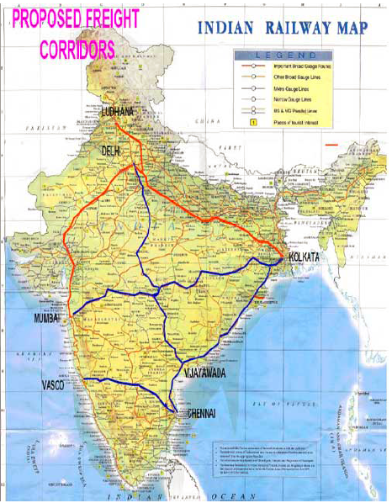
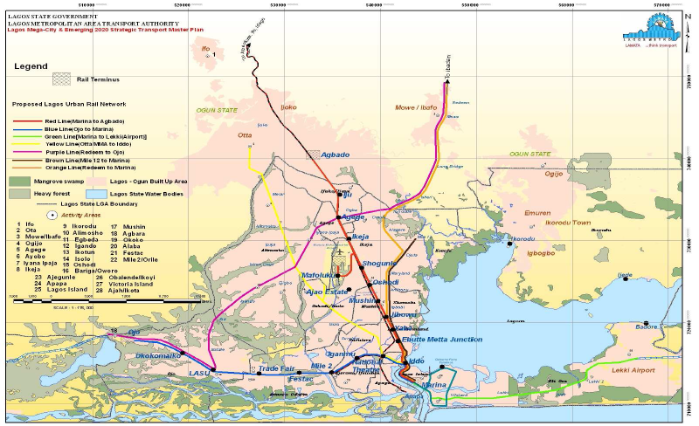
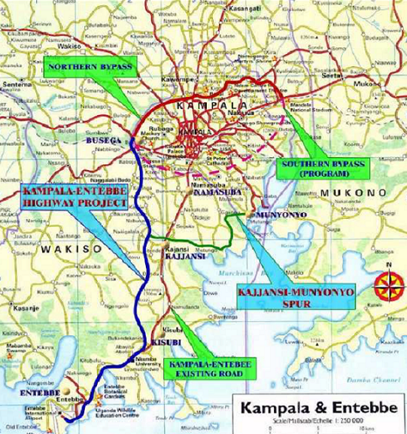
Developing Economies: My sample
India : Dedicated Freight Corridor
Nigeria: Lagos (Lamata)
Uganda: Kampala City Authority;
UNRA
© Nuno A. Gil. All Rights Reserved

Slide 20
Megaprojects in Developing Economies: What Changes?
Massive infrastructure gap => less ambiguity in business case
But fragile institutions => hard to acquire critical resources: finance, land, political consent
Cash strapped governments=> Megaproject architect per force includes multilateral agencies/development partner
Broken social contracts => Lack of trust in buyer-supplier relationship (flexible contracts ruled out) and in the budget holder (high risk provisions ruled out)
© Nuno A. Gil. All Rights Reserved

Slide 21
Two forms of getting to the end goal
Work with multilateral agencies, e.g., World bank
Kampala Capital City Authority
LAMATA in Lagos
India DFC Western corridor
Work with development agencies, eg. China, Japan
UNRA Kampala-Entebbe Expressway (China)
India DFC Eastern corridor (JICA)
© Nuno A. Gil. All Rights Reserved

Slide 22
Both forms have advantages and disadvantages
Multilateral agencies:
invest substantially in capability development
rigorous monitoring of project progress
no strings attached in regards to contractor involvement
but…slow processes to negotiate finance
Development partners
Negotiating finance can be faster
Attractive loans because of moratorium periods
But most loans are tied….fewer opportunities for capability development, limited market competition
© Nuno A. Gil. All Rights Reserved

Slide 23
Two forms of organizing work
Work with established organizations & turn them around
UNRA: Uganda National Roads Authority
KCCA: Kampala Capital City Authority
Create a new organization
LAMATA: autonomous public agency to modernize Lagos (Nigeria) transport infrastructure
DFCCIL: autonomous public agency created to develop India’s dedicated freight corridor
© Nuno A. Gil. All Rights Reserved

Slide 24
Creating new agency is tempting
Opportunity to raise salaries of officials
Higher salaries crucial to attract expats/capabilities
Opportunity to create ‘lean’ bureaucracy
Opportunity to decentralise decision-making power
But is not sufficient condition to succeed
It still requires political support
It needs to work with other agencies, eg. land evaluation office, enforcement of land acquisition, permits, etc.
It needs governance board members with influence and thus capable to help agency eliminate bottlenecks
© Nuno A. Gil. All Rights Reserved

Slide 25
Crucially, a major unifying problem!
The overlap of the land acquisition process with project delivery => virtually impossible to set upfront reliable final cost and schedule forecasts
Ideation
Planning
(resource acquisition, but for land!)
Land Acquisition Process
Design Development and Implementation
(resource allocation)
© Nuno A. Gil. All Rights Reserved

Slide 26
Capabilities for megaproject leaders
© Nuno A. Gil. All Rights Reserved
Notes:
Like a kaleidoscope in which the view changes as it is rotated, any collaboration can be transformed as issues are addressed in this way

Slide 27
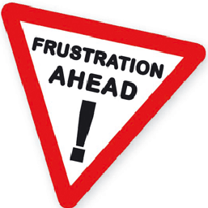
Political Astuteness
Delay public announcements of fixed budgets, opening dates
Introduce ‘soft’ openings (stagger opening date over a period of time ...if at all possible…)
Easy to say, hard to do in democracies due to electoral cycles!
© Nuno A. Gil. All Rights Reserved

Slide 28
Strategically sequence of growth of the megaproject network
Identify development bottlenecks
Build plan to overcome bottlenecks (who can help?)
Align growth of megaproject core with sequence of development decisions (don’t leave steamrollers to the end)
Think judiciously about who you want to keep at bay
Be prepared for disruptive events
© Nuno A. Gil. All Rights Reserved

Slide 29
Strategically sequence of growth of the megaproject network
Identify development bottlenecks
Build plan to overcome bottlenecks (who can help?)
Align growth of megaproject core with sequence of development decisions (don’t leave steamrollers to the end)
Think judiciously about who you want to keep at bay
Be prepared for disruptive events
© Nuno A. Gil. All Rights Reserved

Slide 30
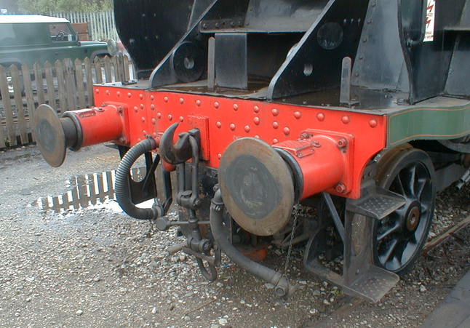
Build organizational slack
Contingencies ‘mask’ slippages in performance targets
But contingencies commit resources that could be better used elsewhere
And the risk is real that the
more resources (time,
money) you throw into the
pot, the more resources
will be spent
© Nuno A. Gil. All Rights Reserved

Slide 31
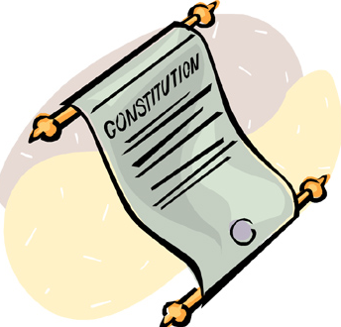
Encourage Collaboration
Have a constitution that sets the high-level rules of the game
Let problem-solving move up and downwards through relationships of mutual deference
Create opportunities for intense face-to-face communication, mutual adjustment, knowledge exchange, but also tough negotiation and bargaining
Communication encourages cooperation, and keeps a lot of the politics at bay
© Nuno A. Gil. All Rights Reserved

Slide 32
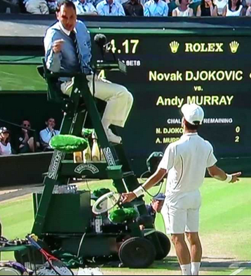
And be pragmatic!
Create a governance structure of nested umpires or referees
Intense communication alone will not solve all controversies when stakes are high and resources scarce
Consensus takes time to reach
Free-riders (narrowly self-interested individuals) ~20% of population !!
© Nuno A. Gil. All Rights Reserved

Slide 33
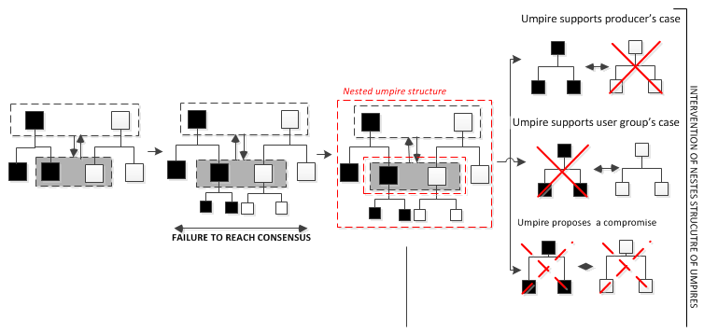
Lack of umpires, urgency to get things done leads to politics
© Nuno A. Gil. All Rights Reserved

Slide 34
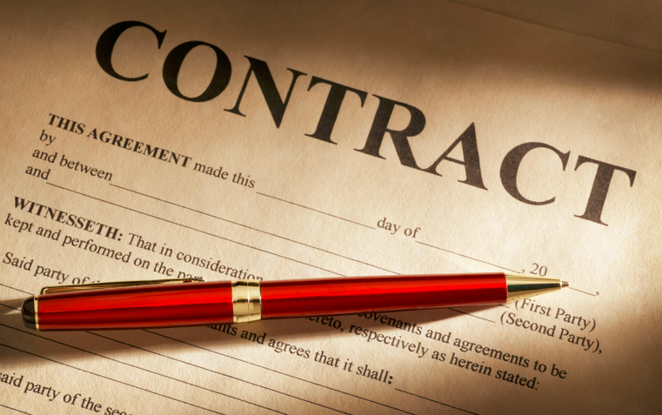
Final Thought: Don’t blame the buyer-supplier contract
Reimbursable contracts with built-in targets are more flexible than fixed price contracts=> likelihood of litigation goes down
And perception that in reimbursable contracts risks are shared brings potentially down bid costs. BUT!!!
Bidders still keep cards close to the chest
As scope changes (or land
fails to become available) claims
surface
© Nuno A. Gil. All Rights Reserved

